Slide 1


BANGALORE TECHNOLOGICAL INSTITUTE Department of Computer Science & Engineering
Democracies Sagacity
For the people by the people

Slide 2
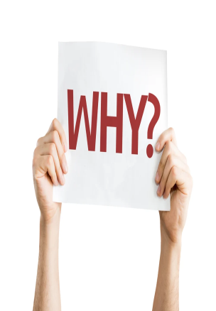
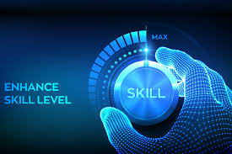
BANGALORE TECHNOLOGICAL INSTITUTE Department of Computer Science & Engineering
PROBLEM STATAMENT:
People in India have least knowledge in terms of assets(investment) , health or finance or other required skills.
People in India also lack skills which help them to attend financial independence, or which make them stand odd out of mob.
The lack of knowledge may be because this types of knowledge primary costs too much money or schools or colleges lack to provide them.
Free resources are already present in the world of web but this type of resources are too complex to fetch or there are heterogeneously organized(like some in form of articles some in form of videos or other in form of audio or roadmaps).
This free resources are so unstructured in the world of big data that it in the long run becomes to complex to search the required information even if the information is gathered its hard that it turns out to be accurate one.
“FREE” has nowadays become an scam or alert seeking way of initially offering free resources and charging them after purchase.

Slide 3
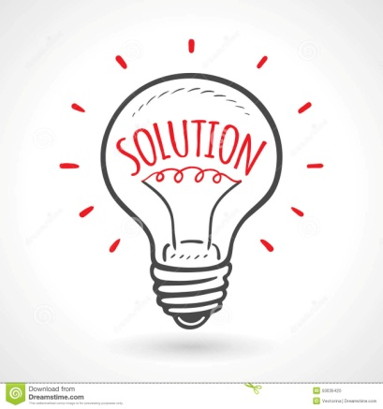
BANGALORE TECHNOLOGICAL INSTITUTE Department of Computer Science & Engineering
SOLUTIONS:
There are various free resources available but there are not completely free hence we have come with an idea of providing structured and free resources in the field of education , finance and healthcare.
Our website will be powered with blockchain technology so that every user can experience the world of blockchain for free and gain required skills and knowledge hand in hand
Our website(marketplace) will have content in the form of articles , roadmaps, videos etc
As the name suggest Democracies(multiparty democracy)the people themselves will create content and earn tokens(content creator)
Also, other people(content consumers)will consume the content by the tokens
Will talk about tokens and blockchain shortly and how the blockchain helps us to achieve this.
Another interesting thing about tokens is how easy it is to create one. Some networks like Ethereum provide templates where you can brand your tokens and start trading. This makes it so anyone with little to no technical knowledge can become a market maker. You'll find a high density of this type of activity on decentralized exchanges, such as Uniswap.

Slide 4
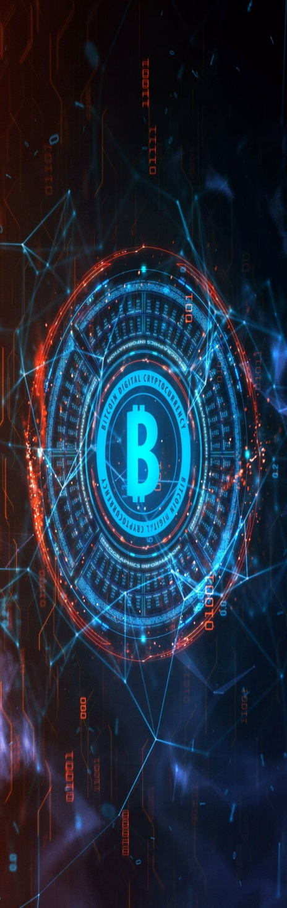
BANGALORE TECHNOLOGICAL INSTITUTE Department of Computer Science & Engineering
WHAT IS BLOCKCHAIN?
A blockchain is a type of distributed ledger technology (DLT) that consists of growing list of records, called blocks, that are securely linked together using cryptography
Each block contains a cryptographic hash of the previous block, a timestamp, and transaction data (generally represented as a Merkle tree, where data nodes are represented by leaves).
The timestamp proves that the transaction data existed when the block was created. Since each block contains information about the previous block, they effectively form a chain (compare linked list data structure), with each additional block linking to the ones before it.
Consequently, blockchain transactions are irreversible in that, once they are recorded, the data in any given block cannot be altered retroactively without altering all subsequent blocks.

Slide 5

BANGALORE TECHNOLOGICAL INSTITUTE Department of Computer Science & Engineering
WHAT IS COIN?
When Bitcoin first came out, it set the standard for what it means to be a coin. There are clear-cut qualities that distinguish crypto coins from tokens, which are similar,to real-world money.
A coin is defined by the following characteristics:
1. Operates on its blockchain. A blockchain keeps track of all transactions that involve its native crypto coin.
When you pay someone with Ethereum, the receipt goes to the Ethereum blockchain. If the same person pays you back later with Bitcoin, the receipt goes to the Bitcoin blockchain. Each transaction is protected by encryption and is accessible by any member of the network.
2. Acts as money. Bitcoin was created for the sole purpose of replacing traditional money. The paradoxical appeal of transparency and anonymity inspired the creation of other coins, including ETH, NEO, and Litecoin.
You can purchase merchandise and services from many major corporations today, such as Amazon, Microsoft, and Tesla, using crypto coins. Bitcoin has recently become an official currency of El Salvador alongside the US dollar.
3. Can be mined. You can earn crypto coins in two ways. One is through traditional mining on the Proof of Work system. Bitcoin hunters employ this method to boost their earnings. The problem with this is that there aren't that many Bitcoins left to mine, so the process becomes more arduous every day.
The other method is Proof of Stake, which is a more modern approach to earning coins. It's lighter on energy consumption and easier to do. Cardano is one of the biggest coins that adopt this system.

Slide 6
BANGALORE TECHNOLOGICAL INSTITUTE Department of Computer Science & Engineering
WHAT IS TOKEN?
Unlike coins, tokens do not have their blockchain. Instead, they operate on other crypto coins' blockchains, such as Ethereum. Some of the most commonly seen tokens on Ethereum include BAT, BNT, Tether, and various stablecoins like the USDC.
If crypto coin transactions are handled by blockchain, then tokens rely on smart contracts. They're an array of codes that facilitate trades or payments between users. Each blockchain uses its smart contract. For example, Ethereum uses ERC-20, and NEO uses Nep-5.
When a token is spent, it physically moves from one place to another. A great example of this is the trading of NFTs (non-fungible tokens.) They are one-of-a-kind items, so a change in ownership must be manually handled. NFTs often carry only sentimental or artistic value, so in a way, they're similar to utility tokens, except you can't oblige any services.
This is different from coins because crypto coins do not move around; only account balances change. When you transfer money from your bank to someone else's, your money doesn't go anywhere. The bank changed the balances of both accounts and kept the fees. The same thing happens with blockchain - the balance in your wallet changes, and the transaction notes that.
Another notable difference between tokens and coins is what they represent. While crypto coins are essentially digital versions of money, tokens can stand for assets or deeds.
You can buy tokens with coins, but some tokens can carry more value than any of them.

Slide 7
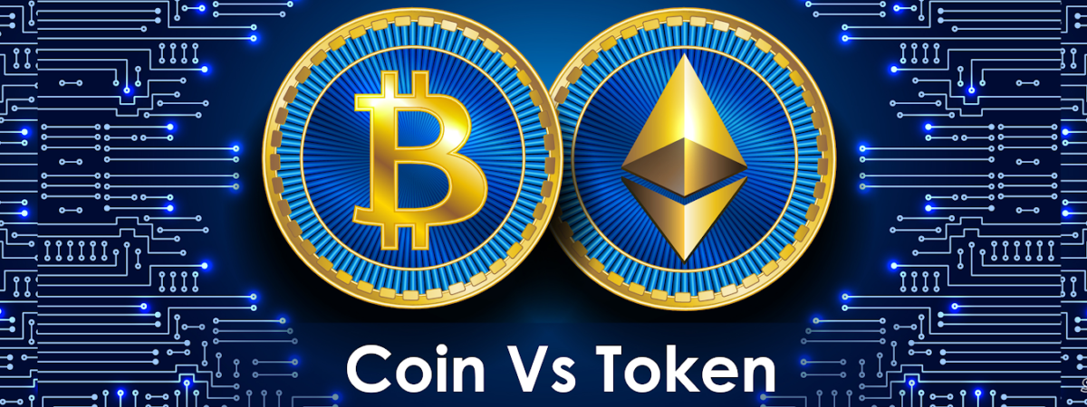
BANGALORE TECHNOLOGICAL INSTITUTE Department of Computer Science & Engineering
WHY TOKENS?
So we have come an idea where content creator creates an thumbnail image representing an NFT of there course with unique identifier
Rather then using the blockchain technology to sell just a piece of image for such an huge price the individual can showcase there teaching and leadership skills by helping the needy ones through their content
The individual who upload content as NFT to our website (which is an marketplace for NFT )they get paid in terms of tokens which can be exchanged as real money.
The individual who wishes to gain knowledge or buy this content can buy through tokens and then that individual block will be assigned to that individual.
The tokens through which individual trade will be called as DFT(Decentralized Fair Tokens).
Building an coin required to have its own blockchain which can also be implemented by forking the available cryptocurrency but mining the coins is the concern of implementation

Slide 8
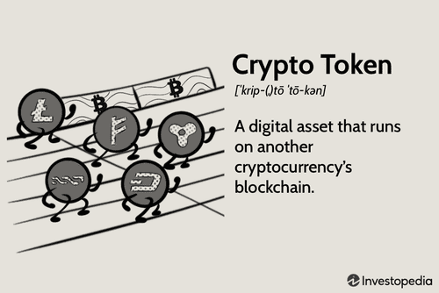
BANGALORE TECHNOLOGICAL INSTITUTE Department of Computer Science & Engineering
A TOKEN WITH SERVICE!!
Trading of NFTs (non-fungible tokens.) They are one-of-a-kind items, so a change in ownership must be manually handled. NFTs often carry only sentimental or artistic value, so in a way, they're similar to utility tokens, except you can't oblige any services.
But our idea is to make a token with service.
And service can be in terms of articles videos or roadmaps etc

Slide 9
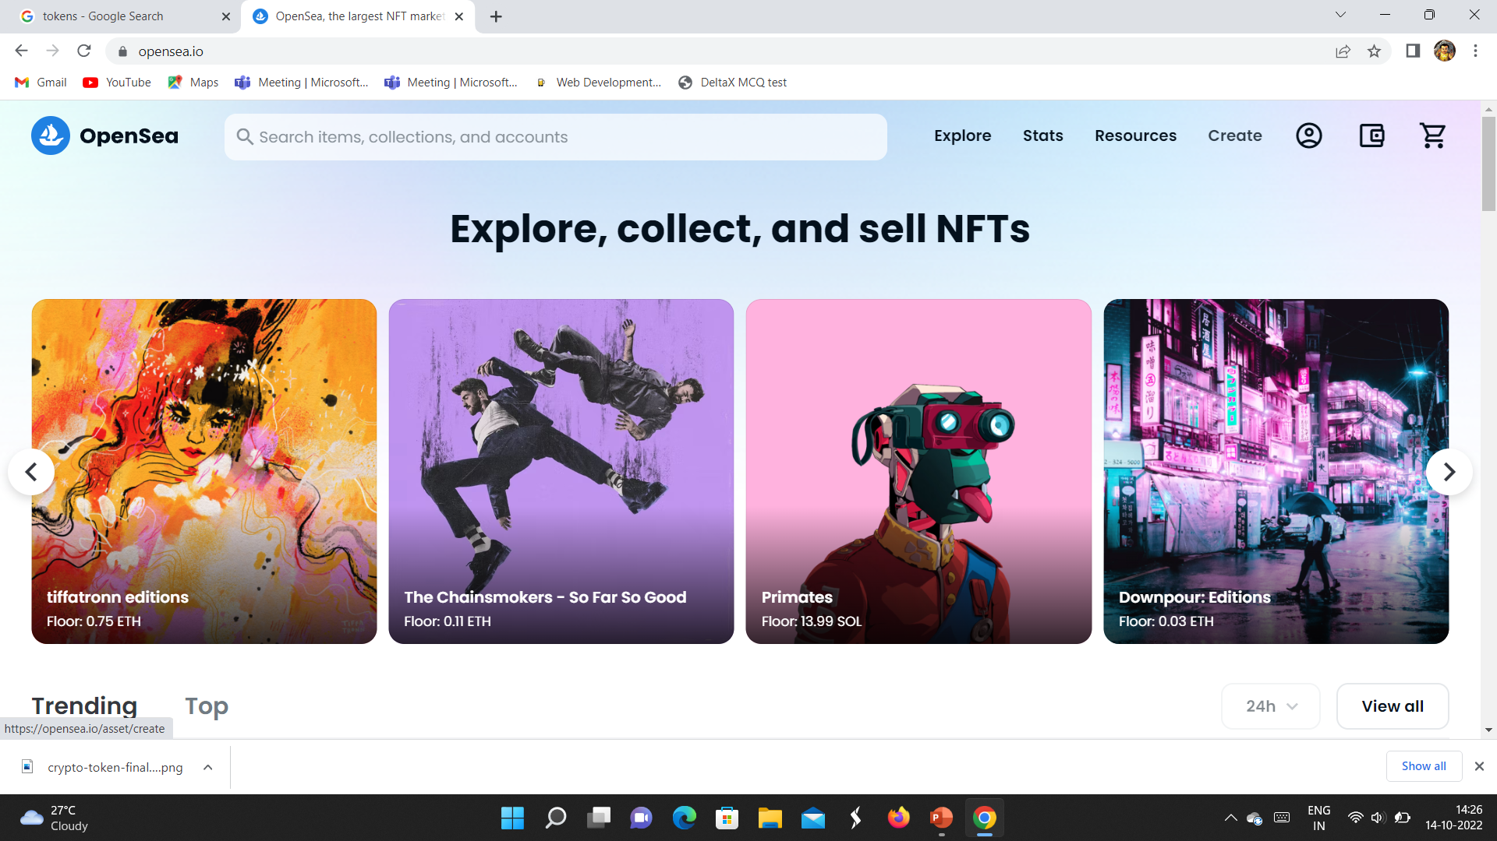
BANGALORE TECHNOLOGICAL INSTITUTE Department of Computer Science & Engineering
WHAT IS MARKETPLACE?
A place where people can mint and sell the NFTs
We have come with an idea of creating our own marketplace for users to mint their content
And also same platform will be used for user to buy the listed NFTs

Slide 10
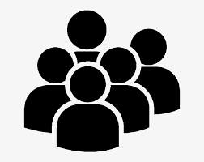
BANGALORE TECHNOLOGICAL INSTITUTE Department of Computer Science & Engineering
ACTORS OF THE WEBSITE
Content creators(one who creates NFTs)
Content consumers(one who buys NFTs)
Enablers(one who enable the above two existence)

Slide 11
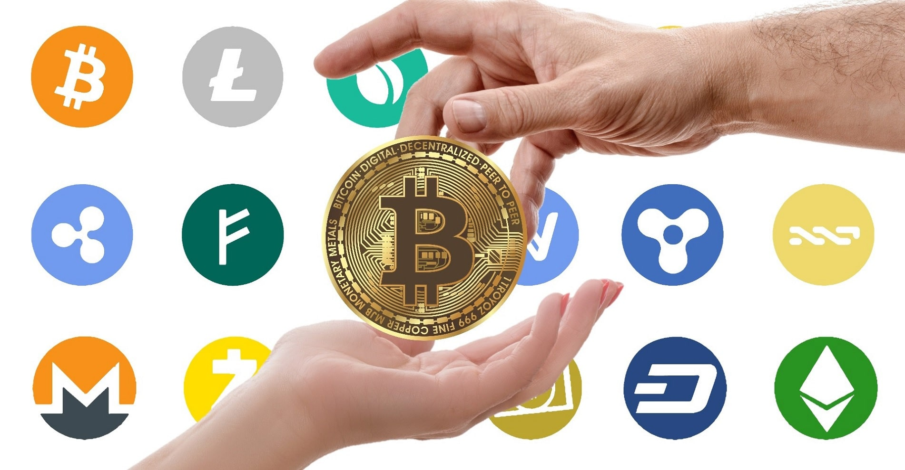
BANGALORE TECHNOLOGICAL INSTITUTE Department of Computer Science & Engineering
TOKENS (THE FUNDAMENTAL UNIT)
The tokens in the website acts as a fundamental unit in for the minting and buying the content listed in the marketplace
However we want the users(content consumers) to access the content free of cost so initially we will be providing them certain amount of DFT for free of cost
If the users(content consumers want to earn extra DFTs they can watch certain ads and earn DFTs or can fill out certain survey form or any of that similar tasks to earn extra DFTs
On the other hand for each of the NFTs sold the marketplace charges certain percent (say 2-4%) as transaction fee(which helps the marketplace to sustain in long run)
Each transaction having in the markerplace will only be DFTs and no other Tokens will be used

Slide 12
BANGALORE TECHNOLOGICAL INSTITUTE Department of Computer Science & Engineering
HOW THE WEBSITE WORKS?
The website is just an marketplace where the content creator(seller) comes and creates an unique block representing that course with an unique identifier and in turn the (buyer)content consumer aggress to the ledger which here is the blockchain and buys the content
After successful purchase of NFT an block will be created in the name(identifier)of the buyer (which here in turn acts as certification)
How ever the entire content is managed by creator which he/she offers to buyer it must first be approved by the website in order to be listed.
However the above case is only applicable for non- monetized content creators
Our Website also offers an separate domain for content creator for management of their participants(consumers)
Scenario:
Suppose say an content consumer(buyer) wants to buy an course related to fitness then he/she comes to our marketplace and filter out the search result course and gets a perfect course and buys that course after successful payment they may receive an redirect(link) to that content made available by content creator(seller)

Slide 13
BANGALORE TECHNOLOGICAL INSTITUTE Department of Computer Science & Engineering
TAGS FOR CONTENT CREATORS:
1.MINED(creator has participant management subscription)
2.MINING(creator has trial version of participant management)
3. UNDERGROUND(creator uses third party participant management tools)

Slide 14
BANGALORE TECHNOLOGICAL INSTITUTE Department of Computer Science & Engineering
General questions and problems with respect to project:
Why choose this platform when there are already free platform available.(YouTube)?

Slide 15
BANGALORE TECHNOLOGICAL INSTITUTE Department of Computer Science & Engineering
General questions and problems with respect to project:
WHY SHOULD CONTENT CONSMER OPT ONLY OUR WEBSITE?

Slide 16
BANGALORE TECHNOLOGICAL INSTITUTE Department of Computer Science & Engineering
CONTENT is everywhere but the proper structured and accurate one matters a lot(UDEMY) and secondarily its Free CONTENT
And moreover, YouTube and other free platform has many contents, but our platform only has educational content(finance , healthcare, skills)
And also there is no Certification in YouTube
Here we also provide certificate which is in turn the block of the NFT.
scenario: suppose we want to learn investing then one channel may say to go for cryptocurrencies while the other say for stock market and say we select stock market and search again related video for which may be not available for us in the same channel.
So here the content creator creates a complete course say in the course section
Our website will have section wise topics to filter and select from
And normal users can also experience the world of blockchain

Slide 17
BANGALORE TECHNOLOGICAL INSTITUTE Department of Computer Science & Engineering
There will also be rating panel for content creators for users to select the required one.
There will also be a tag named mined in certain creator which is to specific that the content creator is genuine one
They will also be an chatbot support for certain users for direct communication with the creator this feature is completely depended on whether the creator wants it or not
Reporting of inappropriate and misleading content is also a feature
Since everything is built on blockchain each NFTS will have their own blocks been created

Slide 18
BANGALORE TECHNOLOGICAL INSTITUTE Department of Computer Science & Engineering
General questions and problems with respect to project:
WHY WILL CONTENT CREATOR UPLOAD HIS CONTENT?

Slide 19
BANGALORE TECHNOLOGICAL INSTITUTE Department of Computer Science & Engineering
As the great saying goes ”there is no free lunch in this world”
Here Content creator can earn DFTs through sells his\her NFTs
After successfully selling certain NFTs the content creator is enable for monetization and he/she can start earning DFTs which can be used to exchange Coins(ICP Coins)
As the value of Tokens go up in the real world the reward for content creator also goes up
Since were are implementing Tokens which will be built using ICP(Internet Computer) blockchain we not worry about mining the coins or miners.
They will also be a tags given to content creator so that user can be sure on type of creator there are spending tokens on.

Slide 20
BANGALORE TECHNOLOGICAL INSTITUTE Department of Computer Science & Engineering
General questions and problems with respect to project:
HOW WILL THE WEBSITE(ENABLERS) SUVIVE IN THE LONG RUN WHEN EVERYTHING IS FREE?

Slide 21
BANGALORE TECHNOLOGICAL INSTITUTE Department of Computer Science & Engineering
Common question may arise like how will the website maintain their servers to be up and running?
How will the website pay to their developers and cloud providers?
The answer is simple the website is just an marketplace where the content creator(seller) comes and creates an unique block representing that course with an unique identifier and in tern the (buyer)content consumer aggress to the ledger which here is the blockchain and buys the content
How ever the website also provides a separate platform for the content creator where he/she can manage their participants
How ever in order to encourage the content creator will also provide free trials to content creators content management domain but there will be tagged in their profile by the tag name ”mining” which helps the consumers to have an idea of what type of creator are their been spending tokens on.
Creator can also manage their participants via third party management tools(MEGA,DROPBOX).

Slide 22
BANGALORE TECHNOLOGICAL INSTITUTE Department of Computer Science & Engineering
Since the website enablers need not worry about the management of data in terms of underground creators.
The website can manage the cloud services and servers with the subscription fee of the creators.
The website also earn money by showing advertisements to the content consumers(buyers).
The website will also earn income by promoting certain content within the marketplace.
Since users(buyers) cannot earn tokens in any other means(not even money)they can only earn as previously discussed and they can also not convert this tokens back to money.(not in case of creator)

Slide 23
BANGALORE TECHNOLOGICAL INSTITUTE Department of Computer Science & Engineering
SUMMARY:
The website is just an marketplace where the content creator(seller) comes and creates an unique block representing that course with an unique identifier and in turn the (buyer)content consumer aggress to the ledger which here is the blockchain and buys the content
They will be three types of content creators(MINED,MINING,UNDERGROUND)for users(consumers)convenience
Creators(sellers) can earn tokens after monetization and in turn convert that tokens to coins(ICP coins)
Consumers(buyers)will be given initially free tokens and can earn extra tokens in terms of tasks(survey , advertisements)
consumers can not convert token back to ICP Coins , here the blockchain for NFT in turn acts as certification

Slide 24

BANGALORE TECHNOLOGICAL INSTITUTE Department of Computer Science & Engineering
CONCLUSION:
As the content creator and consumers are ultimate users of the website and their have their own freedom to choose content in terms of consumer and select the platform for their participation management in terms of creator it acts as an “Democracies”(multiparty democracy) and everything done is the website is gain skills and knowledge in field of education ,healthcare , finance which synonyms to “Sagacity”(intelligence) hence the name come from “DEMOCRACIES SAGACITY”(by the people for the people)

Slide 25
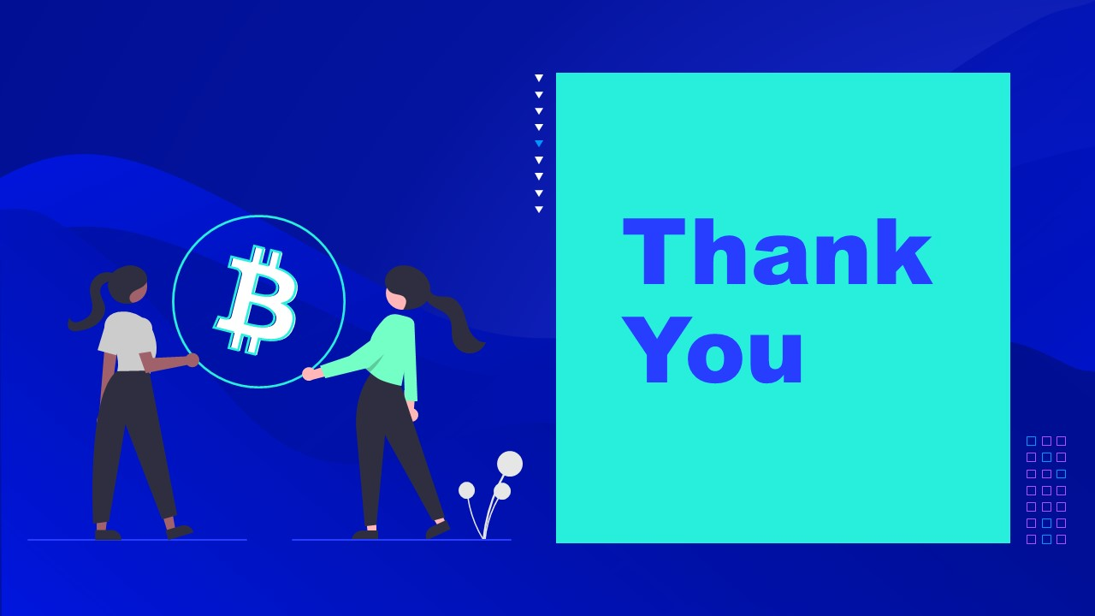
BANGALORE TECHNOLOGICAL INSTITUTE Department of Computer Science & Engineering
TEAM MEMBERS:
NAME: USN:
DINESH CHOUDHARY (1BH19CS025)
K M CHANDRA BABU YADAV (1BH19CS036)
MOHAMMED NAFEEZ N (1BH19CS057)
MOHAMMED SAIF (1BH19CS058)

